Slide 1
PRIVACY PRESERVING MACHINE LEARNING MODELS FOR INTERPOLATION AND FORECASTING ON DELHI POLLUTION DATA
Gauri Gupta
Supervisor: Prof. Rijurekha Sen
Co-supervisor: Prof. RK Sharma
Notes:
GM everyone! Today, I will be talking about my Mtech thesis project i.e.
….
Supervised by Prof. Rijurekha Sen

Slide 2
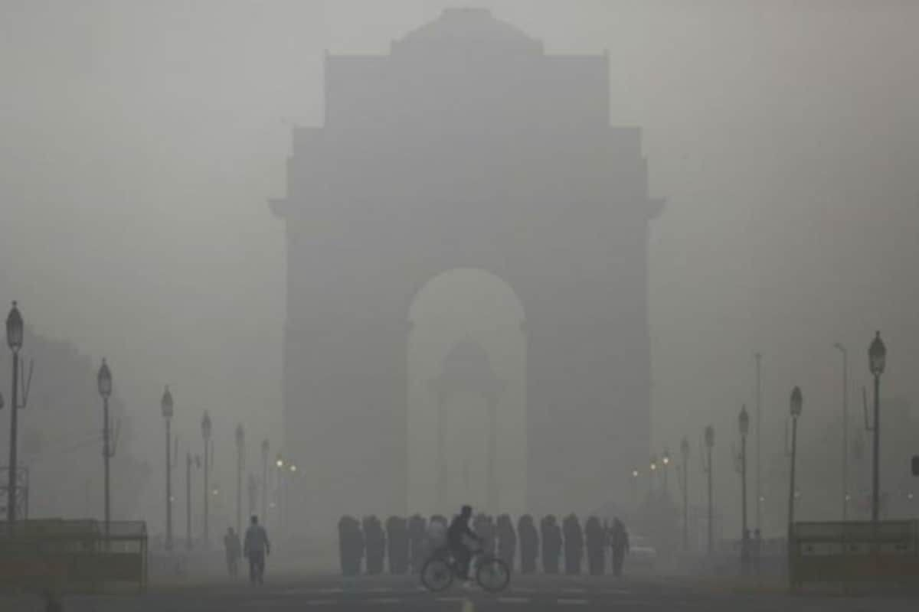
Pollution In Delhi-NCR
Delhi was voted as the most polluted capital city in the world for the last decade.
Pollution levels in Delhi have skyrocketed in winter months (Nov-Jan) increased by 125% over the last decade.
Notes:
Air pollution is one of the biggest concerns faced by developing countries like India and the world at large. Delhi was voted as the most polluted capital city in the world for the last decade. Pollution levels in Delhi have skyrocketed with the peak PM2.5 values in winter months (Nov-Jan) increased by 125\% over the last decade.

Slide 3
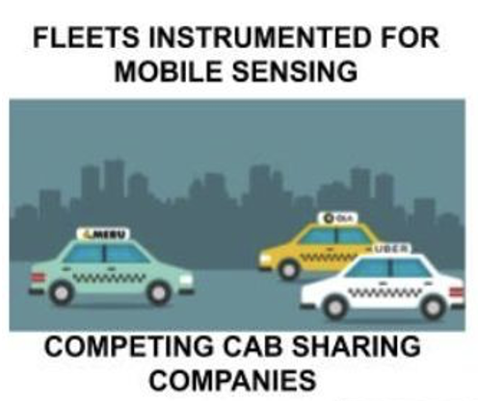

Problem Description
Notes:
Urban phenomena like air pollution have shown to scale using vehicles instrumented with sensing platforms that generate real time and historical pollution data. Fleets vehicles are instrumented with mobile sensors that collect PM data as they roam in the city.

Slide 4
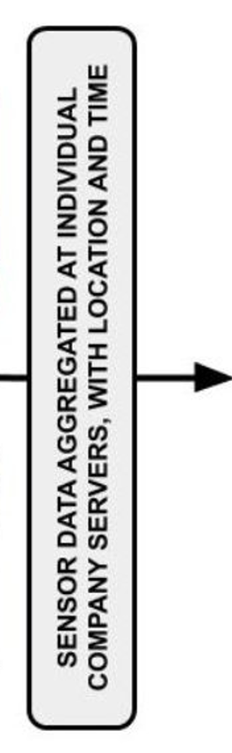
Problem Description
Notes:
The data collected by these sensors are tagged with location, time and PM values.

Slide 5
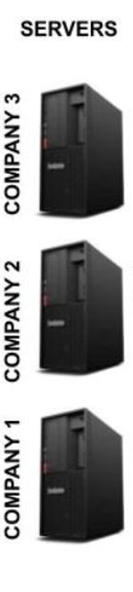
Problem Description
Notes:
This Collected data is sent to the private server of the company.

Slide 6

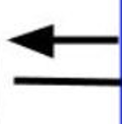
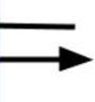

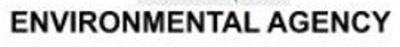

Problem Description
QUERY RESPONSE SYSTEM, PRESERVING LOCATION PRIVACY OF INSTRUMENTED FLEETS AND CLIENTS
Notes:
The clients, for example, ordinary citizens or environmental agencies then queries the server to know the level of pollution on their routes

Slide 7
Problem Description
Secure Client queries
QUERY RESPONSE SYSTEM, PRESERVING LOCATION PRIVACY OF INSTRUMENTED FLEETS AND CLIENTS
Notes:
However, The exact locations queried by these clients is sensitive information, which must be protected.

Slide 8
Threat Model
Sensitive data containing location and time
Secure Client queries
QUERY RESPONSE SYSTEM, PRESERVING LOCATION PRIVACY OF INSTRUMENTED FLEETS AND CLIENTS
Data Provider
Notes:
Publishing sensor data tagged with time and location of the fleets violates privacy. This gives the underlying threat model where cabs or vehicle fleets act as data provider

Slide 9
Threat Model
Sensitive data containing location and time
Secure Client queries
QUERY RESPONSE SYSTEM, PRESERVING LOCATION PRIVACY OF INSTRUMENTED FLEETS AND CLIENTS
Data Provider
Data Consumer
Privacy in Urban Sensing with Instrumented Fleets, Using Air Pollution Monitoring As A Usecase, NDSS’22
Notes:
Whereas rival companies acting as data consumer wants to learn about the business model of the transport partners using fleets spatial distribution information from the data

Slide 10
Threat Model
Sensitive data containing location and time
Private training and inference of ML models
Secure Client queries
QUERY RESPONSE SYSTEM, PRESERVING LOCATION PRIVACY OF INSTRUMENTED FLEETS AND CLIENTS
Data Provider
Data Consumer
Notes:
We support processing of sensor data with ML models in a privacy preserving manner, across competing companies. Finally, client queries need to be answered using the most recent fine-tuned ML model, without revealing model details to client and client location to any server. ML based data processing across competing fleet companies and answering client queries pose significant challenges, if location privacy of both sensors and client queries need to be preserved.

Slide 11
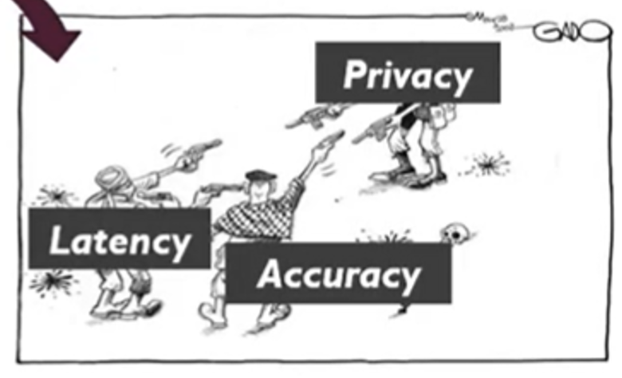
Goal: Balancing Tradeoffs
Sensitive data containing location and time
Private training and inference of ML models
Secure Client queries
Data Provider
Data Consumer
Notes:
To handle these challenges, we adopt a co-design approach between ML modeling and preserving privacy. The goal is to build efficient ML models that preserve privacy with carefully chosen model parameters to balance ML accuracy and MPC computation and communication overheads. At every step of our end-to-end system design, we carefully balance these trade-offs between privacy, accuracy and latency.

Slide 12
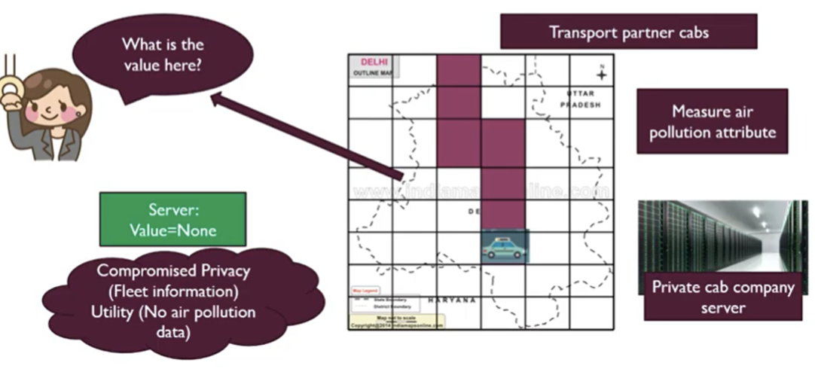
Machine Learning tasks explored
Interpolation: Filling in PM values in locations where no sensors are present at a given time, based on what other sensors in nearby locations are reporting.
Using GCN and GP (already presented as part of MTP-1)
Forecasting: Predicting PM values at some future time point, based on historical and current values.
Notes:
Many interesting Machine Learning (ML) problems can be formulated on vehicle collected PM datasets. While mobile sensors values are not collected at all places at all times, with state of the art spatio-temporal interpolation and forecasting techniques, values where no sensors are present at a particular time can be estimated.
Interpolation is answering queries about PM values at locations where no sensor is present, based on sensed values at other neighboring locations
Whereas forecasting i.e. answering queries about PM values at some future time point, based on historical and current values.
Thus the Machine Learning Problem of interest here is that of training spatio-temporal models for interpolation and forecasting across competing companies, preserving location privacy of individual data points. As pollution is a temporally evolving phenomena, fine-tuning the trained model with fresh incoming data periodically, again preserving privacy is needed.
While we have already looked at interpolation using GCN and GP during previous presentations, today I will talk about forecasting using PM values.
First, we will look at the the forecasting problem in detail and the careful choice of the ML model and its parameters.

Slide 13
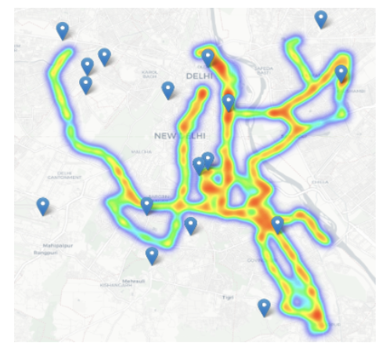
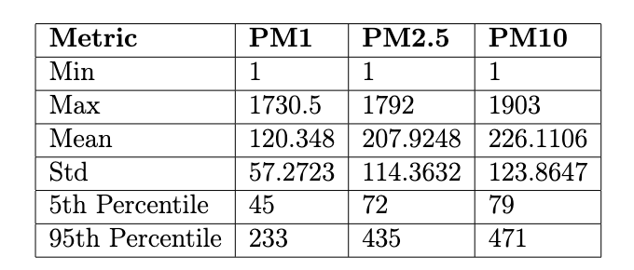
Delhi Pollution Dataset – IIT Delhi
The Particulate Matter (PM) dataset for Delhi-NCR contains PM data recorded over three months from November 2020 to January 2021.
Vehicle-mounted IoT sensors were deployed on 13 public buses that travelled across different routes and collected PM readings at intervals of few seconds.
The dataset contains more than 12.5 million sensor data points and spans an area of 559 square Kms. The dataset is public at (http://www.cse.iitd.ac.in/pollutiondata/)
Aggregated PM statistics for Delhi Pollution Dataset
Notes:
The Particulate Matter (PM) dataset for Delhi-NCR contains PM data recorded over three months from November 2020 to January 2021. The data has been collected using vehicle-mounted IoT sensors, deployed on 13 public buses that travelled across different routes and collected PM readings at intervals of few seconds. The Figure shows an example of the spatial coverage by public buses on 3 routes in New Delhi.
The dataset contains more than 12.5 million sensor data points and spans an area of 559 square Kms. It consists of three kinds of pollutants i.e. PM1, PM2.5, PM10 collected over a period of 91 days. Table \ref{tab:pm_stats} shows the aggregated statistics of PM values in the dataset.

Slide 14
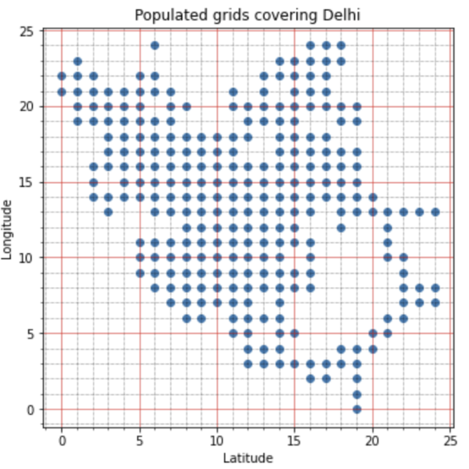
Data Preparation
We divide the regions of the city into (25*25) small grids of sizes ~0.9 km²
Out of these total 625 grid locations, 270 of these are actually populated
Notes:
We divide the regions of the city into (25*25) small grids of sizes ~0.9 km². Any sensor reading that falls within the boundaries of the grid is binned as an event of that grid.
Out of these total 625 grid locations, 270 of these are actually populated with data from our local buses at different timestamps spread across 3 months.

Slide 15
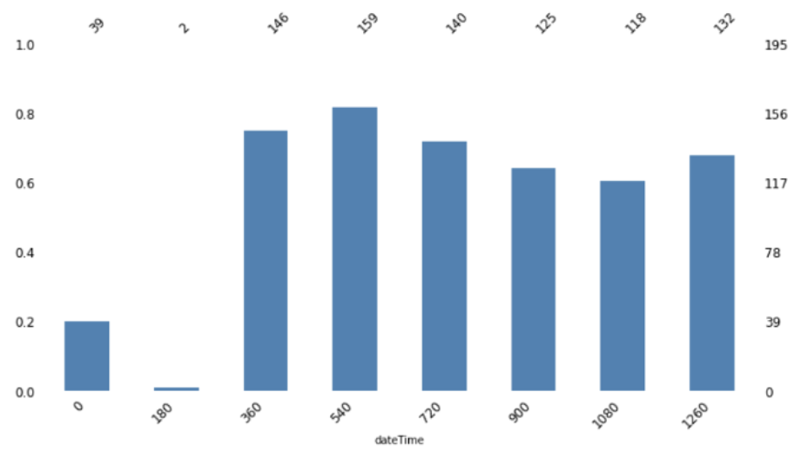
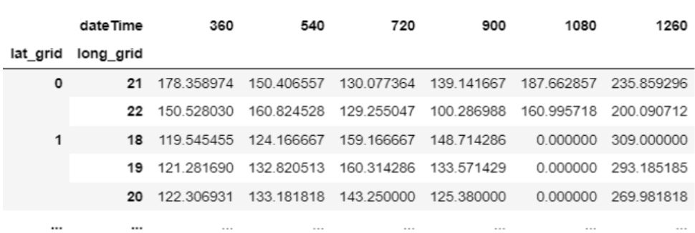
Data Preparation Contd..
We discretize the time space into buckets of 3-hr duration.
We drop the first two buckets i.e. between 12AM-6AM from our time-series construction as there are only 20% and 1% values respectively.
Finally, each grid location is a vector of size 6 of aggregated PM2.5 values over an interval of 3-hr from 6AM-12 midnight and 0 wherever missing.
Notes:
Next we discretize the time space into buckets of 3-hr duration. For a given grid location, an event is considered as a mean of all PM2.5 readings within the 3-hr window lying in the boundaries of the grid location. we have only 20% and 1% values collected in the first two buckets respectively. Since this is the time when the buses are not operational, we drop the first two buckets i.e. between 12AM-6AM from our time-series construction.
Finally, the time-series for a single day is such that, each grid location is a vector of size 6 filled with aggregated PM2.5 values collected over an interval of 3-hr from 6AM-12 midnight and 0 wherever missing

Slide 16
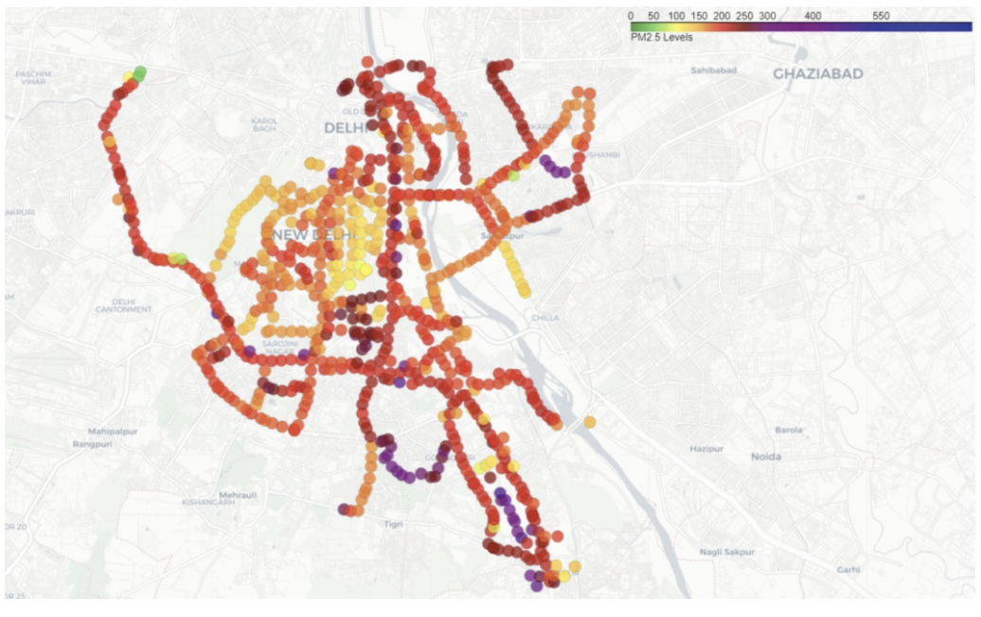
Identifying Patterns in Data
Spatial Patterns
Lighter colored points indicate lesser pollution levels while darker colored points indicate more pollution levels.
Nearby locations are similar in color.
Acquiring these complex spatial dependence is a key challenge in air pollution prediction.
Notes:
We explore the inherent patterns or trends in the variation of PM values. These patterns, if they exist, are captured by the models and aid in the downstream tasks of interpolation and forecasting investigated in this work.
The figure shows the average PM2.5 values on a single day in the month of December for the points in our trajectories. Lighter colored points indicate lesser pollution levels while darker colored points indicate more pollution levels.
Spatial patterns are evident from this plot, that nearby locations are similar in colour. As pollution depends on spatial features like green cover or presence of local pollutant sources or traffic hotspots, similarity in PM for nearby locations is intuitive.

Slide 17
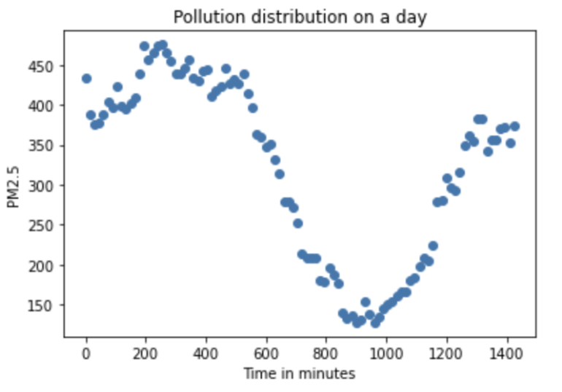
Identifying Patterns in Data
Temporal Patterns
Higher PM values at night, and the lowest around 3 pm everyday.
Notes:
Temporal Patterns
Next we also explore the temporal patterns in the data. Fig shows the average PM2.5 distribution within a day has higher PM values at night, and the lowest around 3 pm everyday. This validates the known meteorological effect that temperature is negatively correlated with PM as heat expands the air, reducing PM concentration.

Slide 18
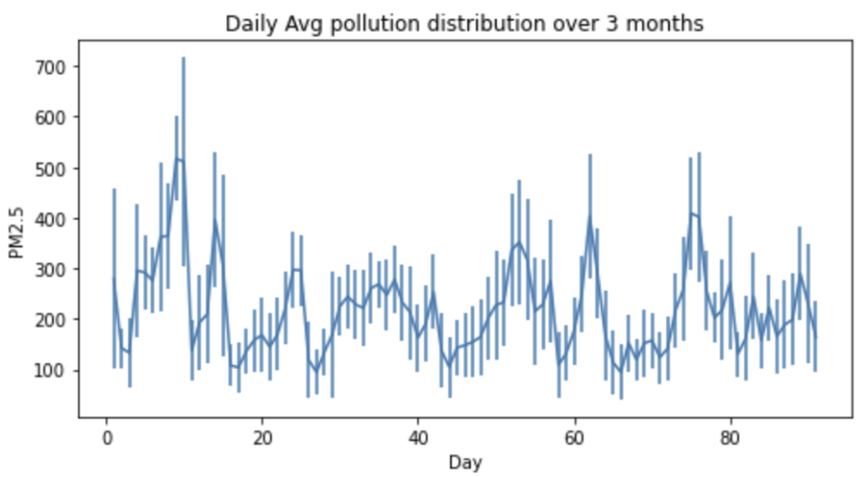
Identifying Patterns in Data
Temporal Patterns
Higher PM values at night, and the lowest around 3 pm everyday.
As we can see from these Figure 2, there is no defined long-term temporal pattern in the Delhi Pollution Dataset.
Forecasting PM values later in future, seems non-trivial, using PM data itself.
In this project, we focus on short term forecasting for the next 3-hrs windows
Notes:
The second Figure shows the average PM2.5 distribution across the 3 months. there is no defined long-term temporal pattern in the Dataset.
Thus, forecasting PM values later in longer future seems non-trivial, using PM data itself. Hence we do not explore long term forecasting in this work, but focus on short term forecasting for the next 3hr windows for a day

Slide 19
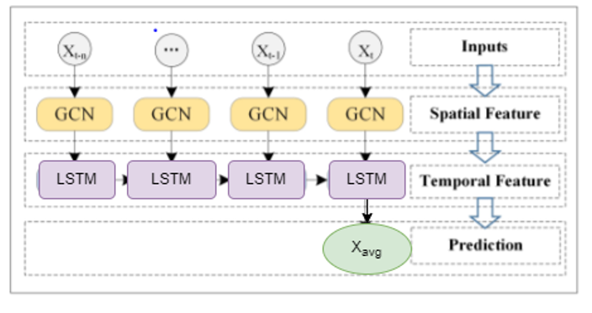
Our Model GCN-LSTM for forecasting
The GCN-LSTM model integrates the graph convolutional network and Long Short Term Memory (LSTM) units.
The GCN is used to capture the topological structure of the sensors for modeling spatial dependence.
The LSTM unit is used to capture the dynamic change of pollution data for modelling temporal dependence.
The dropout layers and a dense layer at the end improve the model performance and manages over-fitting.
Notes:
We propose GCN-LSTM spatio-temporal model for forecasting delhi pollution data
The model consists of multiple graph convolution layers stacked over multiple LSTM layers. GCN is used to capture topological structure of the network for obtaining the spatial features. Second, the obtained time series with spatial features are input into LSTM unit model and the dynamic change is obtained by information transmission between the LSTM units, to capture temporal features. Finally, to increase performance and manage over-fitting, a dropout layer and a dense layer are also added at the end

Slide 20

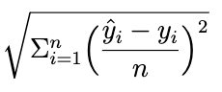
Evaluation Metric (RMSE)
RMSE: Root Mean Squared Error (RMSE) defined as
Equivalent to the standard deviation of the residuals, or prediction errors.
A lower RMSE indicates better performance and more accurate predictions.
Notes:
We use RMSE: the Root Mean Squared Error (RMSE) as the evaluation metric for models performance. It is sum of the squared distance between the observed and the expected values. It then takes the square root of this sum, which effectively makes the RMSE equivalent to the standard deviation of the residuals, or prediction errors. Therefore, a lower RMSE indicates better performance and more accurate
predictions.

Slide 21
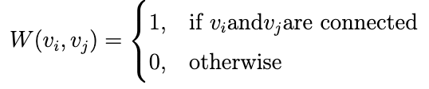
Experimental Setup
The grid is modelled as a graph G as {V, W }, where V = {v_{i}, i = 1, . . . 270} and W the adjacency matrix.
The adjacency matrix W is used to represent the connection between adjacent grid points. W is a 0-1 adjacency matrix where
We say v_{i} and v_{j} are connected if v_{j} is among the first 8 (excluding self) closest neighboring nodes to v_{i} based on the Euclidean distance
We combine the data from 7 consecutive days and construct a time-series. The first 6 days form the train set and the model is tested on the 7th day.
We test our model on several test days spread across the 3 including 15 Nov, 28 Nov, 28 Nov, 7 Dec, 15 Dec, 7 Jan, 10 Jan, and 24 Jan. Each test day is evaluated on previous 6 days of the training data in the past.
Notes:
The grid is modelled as a graph G as {V, W }, where V = {vi, i = 1, . . . 270} and W the adjacency matrix. Nodes on the graph represent grid points and the edges represent the connection relationships between these grid locations or sensors. W is a 0-1 adjacency matrix with value 1 when vi and vj are connected We say vi and vj are connected if vj is among the first 8 (excluding self) neighbors of vi based on the euclidean distance .
We first split the data into train and test sets. However, in time-series, the data is in some chronological time respecting order and the train/test split happens along the time axis. We combine the data from 7 consecutive days and construct a time-series. The first 6 days form the train set and the model is tested on the 7th day. We test our model on several test days spread across the 3 months and report the average evaluation numbers.
The test days include 15 Nov, 28 Nov, 28 Nov, 7 Dec, 15 Dec, 7 Jan, 10 Jan, and 24 Jan. Each test day is evaluated on previous 6 days o the training data in the past.

Slide 22
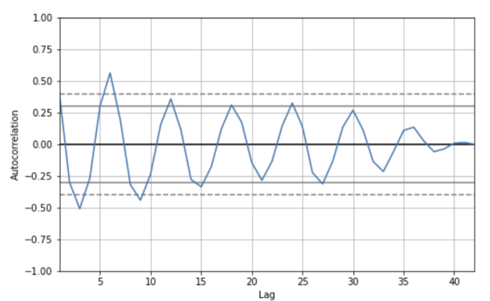
EDA for Size of the past window
seq_len is, the size of the past window of information to be used for LSTM modelling.
The Autocorrelation Function (ACF), helps to identify which lags have significant correlations. These correlations indicate that past values influence the current value.
Figure shows that lag 6 has large positive correlations and correlations taper off slowly as the lags increase.
This can also be confirmed empirically as the observations y_{t} and y_{t−6} correspond to the same time-buckets 1 day apart.
Thus, we chose the parameter seq_len = 6 for modelling the time-series.
Notes:
we first study parameter seq_len which is, the size of the past window of information to be used for LSTM modelling.
The Autocorrelation Function (ACF), helps to identify which lags have significant correlations, and understand the patterns and properties of the time series. these correlations indicate that past values influence the current value. Figure shows that lag 6 has large positive correlations and correlations taper off slowly as the lags increase. That means, the observations yt and yt−6 are highly correlated. This can also be confirmed empirically as the observations yt and yt−6 correspond to the same time-buckets 1 day apart. As one single day has 6 time-buckets. Thus, we chose the parameter seq_len = 6 for modelling the time-series.

Slide 23
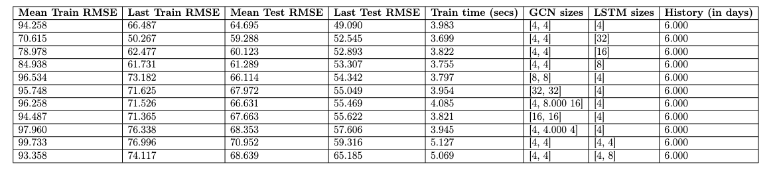
GCN and LSTM layers architecture choice
The architecture of GCN-LSTM has custom support for the user defined number of graph convolutional layers and LSTM layers. We perform experiment with varying number of layers in both the GCN and LSTM with custom sizes as well.
Table shows that the GCN-LSTM architecture with 2 GCN layers with [4, 4] size and 1 LSTM layer with 4 units gives the best test RMSE results on the test data.
Notes:
The architecture of GCN-LSTM has custom support for the user defined number of graph convolutional layers and LSTM layers. We perform experiment with varying number of layers in both the GCN and LSTM with custom sizes as well.
Table shows that the GCN-LSTM architecture with 2 GCN layers with [4, 4] size and 1 LSTM layer with 4 units gives the best test RMSE results on the test data. This small model not only gives better RMSEs but also low computations overhead in private training.

Slide 24
Training Procedure
Training from scratch
We train the model again from scratch with randomly initialized model weights for every new stream of incoming data
Notes:
Since the problem of forecasting is based on incoming streams of time-series data, we evaluate two training procedures for training our model new incoming streams using the above mentioned architecture choice
Training from scratch
as we have a new stream of data from the next day, we move our training window by 1 day and train the model again from scratch with randomly initialized model weights again with a learning rate of 0.01
Let us assume we first evaluate our model on day T by training it on the data of the past 6 days from day T − 7 to day T − 1 using a learning rate of 0.01. Now, as we have a new stream of data from the next T + 1 day, we move our training window by 1 day from day T − 6 to day T . In doing so, we train the model again from scratch with randomly initialised model weights again with a learning rate of 0.01 each time we move our training window by 1 day.

Slide 25
Training Procedure
Training from scratch
We train the model again from scratch with randomly initialized model weights for every new stream of incoming data
Fine-tuning
In this training procedure, we fine-tune the previously learned weights with a lower learning rate, as and when we receive new streams of pollution data from the incoming days.
Notes:
Fine-tuning
In this training procedure, we instead of randomly initializing the model weights, we fine-tune the previously learned weights with a lower learning rate as and when we receive new streams of pollution data from the incoming days. We us lr = 0.004, which is the best hyperparameter found in the grid-search.

Slide 26
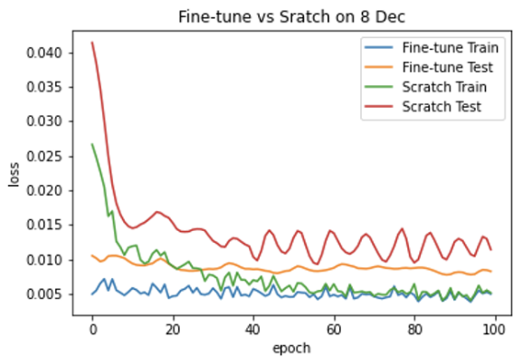
Training Procedure
Training from scratch
We train the model again from scratch with randomly initialized model weights for every new stream of incoming data
Fine-tuning
In this training procedure, we fine-tune the previously learned weights with a lower learning rate, as and when we receive new streams of pollution data from the incoming days.
Figure shows training plots for both the methods on 8 Dec. We can see that training with fine-tune converges much faster and smoothly than training-from scratch.
Finally, we propose fine-tuning our model with with lower learning rate = 0.004 for the incoming streams of data for each day as it gives better results and Test RMSE values.
Notes:
We compare the two training-procedures and As evident form the evaluations, fine-tuning training procedure yields better results and Test RMSE values. Figure \ref{fig:train_plots}
shows training plots for both the methods on 8 Dec and 9 Dec. Both these plots show that training with fine-tune converges much faster and smoothly than training-from scratch. Finally, we propose fine-tuning our model with with lower learning rate = 0.004 for the incoming streams of data for each day.

Slide 27
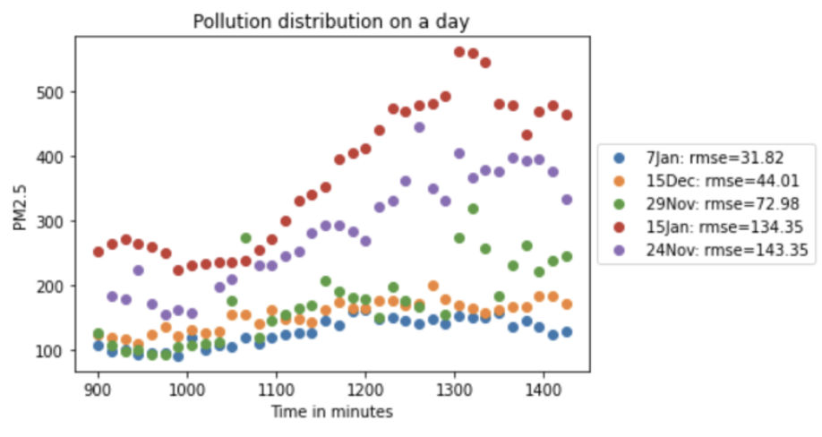
RMSE trend with Pollution distribution
As we can see, on several days like 15 Jan, the pollution itself ranges between ~200-550 PM2.5 levels. This wide variations in the PM values on a single day itself leads to poor model predictions with RMSE of ~130-150.
Whereas on days, where the PM values do not fluctuate much, the model is able to make good predictions with RMSE of around 30.
Notes:
Pollution is a very dynamic phenomenon. The pollution levels vary greatly between months and even within a single day, making air pollution forecasting for the entire city a challenging task.
Figure shows the test RMSE values on different days along with their pollution distribution throughout the day. As we can see, on several days like $15 Jan$, the pollution itself ranges between $~200-550$ PM2.5 levels. This wide variations in the PM values on a single day itself leads to poor model predictions with higher RMSE of $~130-150$.
Whereas on days, where the PM values do not fluctuate much, the model is able to make good predictions with RMSE of around 30.
As a result, large variations in true PM values over a single day result in poor model predictions, which are reflected in high RMSE values.

Slide 28
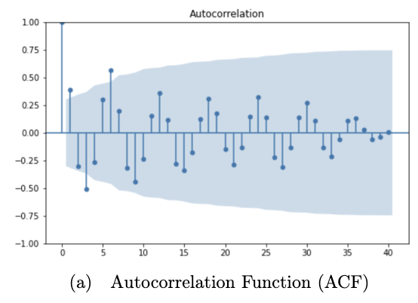
Baselines - ARIMA
ARIMA is a statistical time-series forecasting model that uses linear regression.
ARIMA stands for Auto-Regressive Integrated Moving Average with following parameters:
p: The number of lag observations included in the model
d: The number of times raw observations are differenced
q: The size of the moving average window
For our dataset, we use ARIMA with parameters (5, 1, 1)
The data is prepared by a degree of differencing in order to make it stationary, i.e. to remove trend and seasonal structures that negatively affect the regression model
Notes:
We compare our model with simple statistical baselines like ARIMA.
ARIMA stands for Auto Regressive Integrated Moving Average is a statistical time-series forecasting model that uses Linear Regression to make predictions. ARIMA has 3 parameters defined as
p: The number of lag observations included in the model, also called the lag order. d: The number of times that the raw observations are differenced, also called the degree of difference. q: The size of the moving average window, also called the order of moving average.
For our dataset, we use ARIMA with parameters (5, 1, 1) after a careful analysis of the data
A linear regression model is constructed including the specified number and type of terms, and the data is prepared by a degree of differencing in order to make it stationary, i.e. to remove trend and seasonal structures that negatively affect the regression model.

Slide 29
Baselines – N-BEATS by Darts
Darts is a Python library for easy manipulation and forecasting of time-series.
It provides support for multiple statistical forecasting techniques in time-series as well as state-of-the-art deep neural networks based forecasting models.
N-BEATS is a state-of-the-art model that shows the potential of pure DL architectures in the context of the time-series forecasting. It outperforms well-established statistical approaches.
https://github.com/unit8co/darts
Notes:
We also compare it with heavy deep learning models like N-beats by Darts. Darts is a Python library for easy manipulation and forecasting of time-series.
It provides support for multiple statistical forecasting techniques in time-series as well as state-of-the-art deep neural networks based forecasting models. We use N-BEATS inbuilt model from Darts as one of our baseline. N-BEATS is a state-of-the-art ML model built for time-series forecasting. It outperforms well-established statistical approaches.

Slide 30
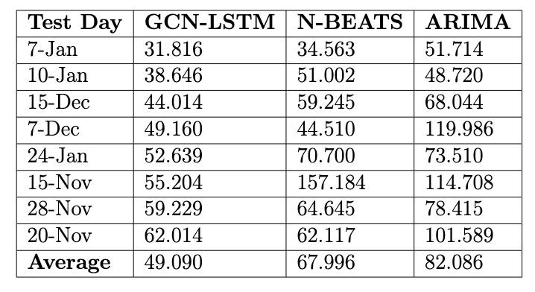
Results
Table also shows the evaluations GCN-LSTM and the two baselines we have, ARIMA: statistical approach for time-series forecasting and N-BEATS: state-of-the-art model ML based forecasting model.
We can clearly see that our construction of GCN-LSTM model on the Delhi PM Dataset outperforms both these baselines including state-of-the-art-models.
Notes:
We present the evaluation of our GCN-LSTM model with the above defined model parameters and the two baselines ARIMA and Nbeats on the different test days as shown in the table.
We can clearly see that our construction of GCN-LSTM model on the Delhi PM Dataset outperforms both these baselines including state-of-the-art-models. Our model GCN-lstm gives an average test RMSE of 49 on the test data whereas ~68 in N-beats and 82 in ARIMA

Slide 31
Secure private training of GCN-LSTM
The secure training of the GCN-LSTM was implemented using use state-of-the-art MPC framework with the Secfloat (Oakland’22) backend in collaboration with MSR.
Secfloat provides privacy guarantees in 2PC with upto to 2x more efficient and 6x more precise than existing libraries.
The fine-tuning of the model was carried out for 20 epochs, with a runtime of 6014.2 seconds (~1.6 hr) and a total communication of 297.27 GiB to predict next 3-hr
Latency vs accuracy tradeoffs at each step led to careful choice of the ML model parameters (architecture, #layers, sequence length, grid size, time units, how much history, scratch train for 100 epochs vs. finteune for 20 epochs)
Practical to train ML models on contiguous streaming data in a secure manner, balancing ML accuracy and MPC computation and communication overheads.
SECFLOAT: Accurate Floating-Point meets Secure 2-Party Computation, Oakland’22
Notes:
Let us now briefly look at the Secure private training of GCN-LSTM
The secure training of the GCN-LSTM was implemented using the state-of-the-art MPC framework with the Secfloat backend developed by Microsoft research India.
Secfloat is a computational-friendly cryptographic framework that provides privacy guarantees in 2PC and is upto to 2x more efficient and 6x more precitose than existing libraries.
The fine-tuning of the model was carried out for 20 epochs, with a runtime of 6014.2 seconds (~1.6 hr) to predict the PM values for the next 3-hr window
Latency vs accuracy tradeoffs analyzed at each step of the model training. We achieve this training time and latency with our careful choice of the ML model parameters (architecture, #layers, sequence length, grid size, time units, how much history, training from scratch for 100 epochs vs. finteune for 20 epochs)
we thus show it is indeed practical to train useful ML models on contiguous streaming data in a secure manner, if the model parameters are chosen carefully to balance ML accuracy and MPC computation and communication overheads.

Slide 32
Future Work
Extending ML architecture elements:
Improve RMSE further to make our model more robust (maybe add attention?)
Adding auxiliary datasets:
Several spatio-temporal factors influence air quality and PM values. For example, temperature, humidity, precipitation, the wind speed, wind direction, traffic data etc. make air pollution varies from locations to locations. We want to further incorporate the metorological data for prediction of more accurate pollution values.
Other ML problems like long-term PM forecasting or correlating PM to contributing factors, would need these auxiliary datasets. We will expand to these additional ML tasks in future, as richer auxiliary datasets become available.
Notes:
Some of the future works that holds for us is:
1. Extending ML architecture elements: we can further improve the model performance to make our model more robust maybe by adding attention layers …
2. Adding auxiliary datasets: There are many factors influence air quality and PM values. For example, temperature, humidity, precipitaion, the wind speed, wind direction make air pollution varies from locations to locations. We want to further incorporate the metorological data for prediction of more accurate pollution values. Other ML problems like long-term PM forecasting or correlating PM to contributing factors, would need these auxiliary datasets. We will expand to these additional ML tasks in future, as we have access to richer auxiliary datasets.

Slide 33
THANK YOU!!!

